Slide 1
Enterprise Service Bus
(ESB)

Slide 2






Electronic Health Records System
Insurance Billing System
Appointment System
Pharmacy Services System
Laboratory Services System
Emergency Services System

Slide 3

JSON! 😀
XML?? 😕
JSON! 😀
JSON! 😀
JSON! 😀

Slide 4
Electronic Health Records System
Insurance Billing System
Appointment System
Pharmacy Services System
Laboratory Services System
Emergency Services System

Slide 5

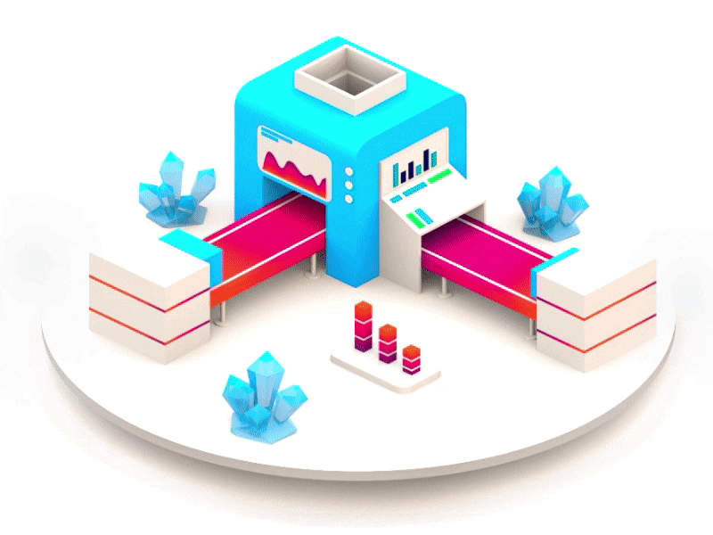


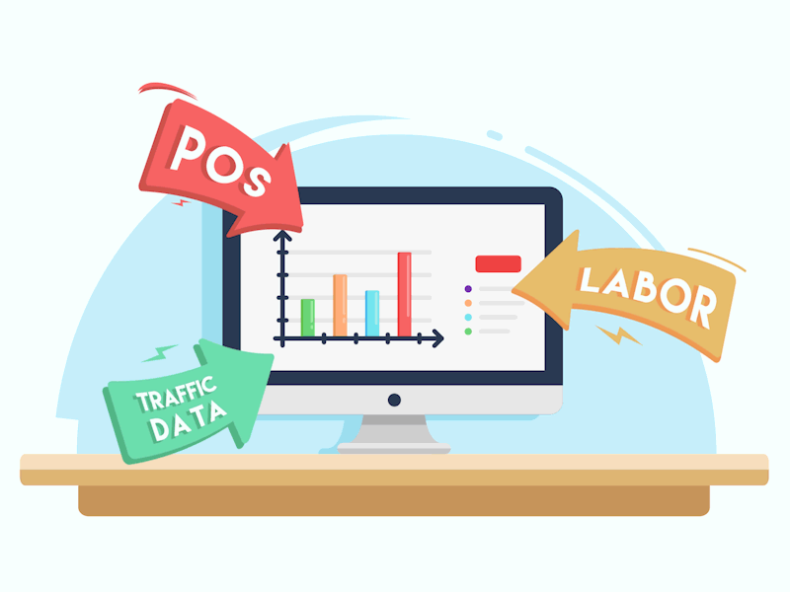
Key Functions
Message Queueing
Security
Data Transformation
Workflow Automation
Logging & Monitoring

Slide 6

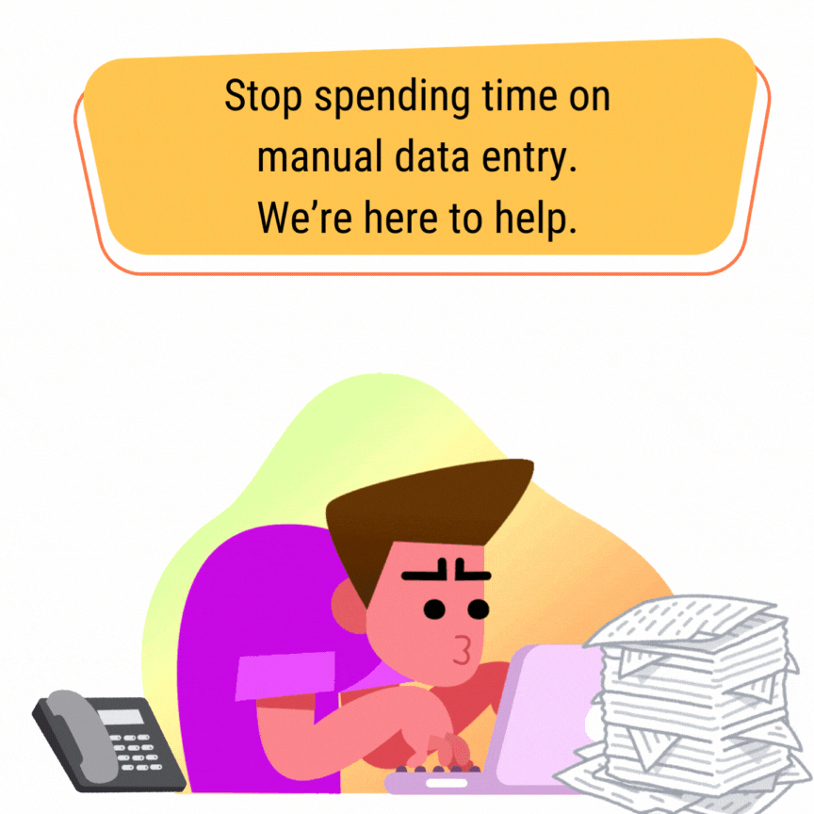





Pros and Cons
Seamless
Integration
Reduce manual data entry & errors
Automated
Workflows
Enhances Security Compliance
Complexity if not implemented properly.
Single Point of
Failure
Performance
Overhead

Slide 7




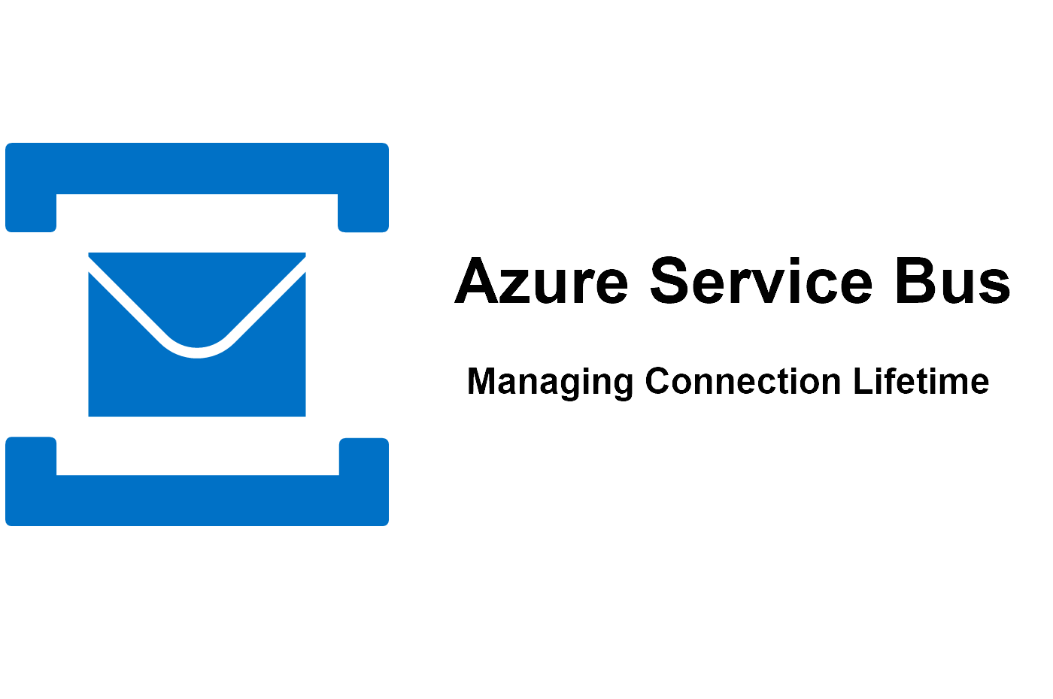

Examples of ESB's

